Slide 2
Unit 4
10.4.25

Slide 3
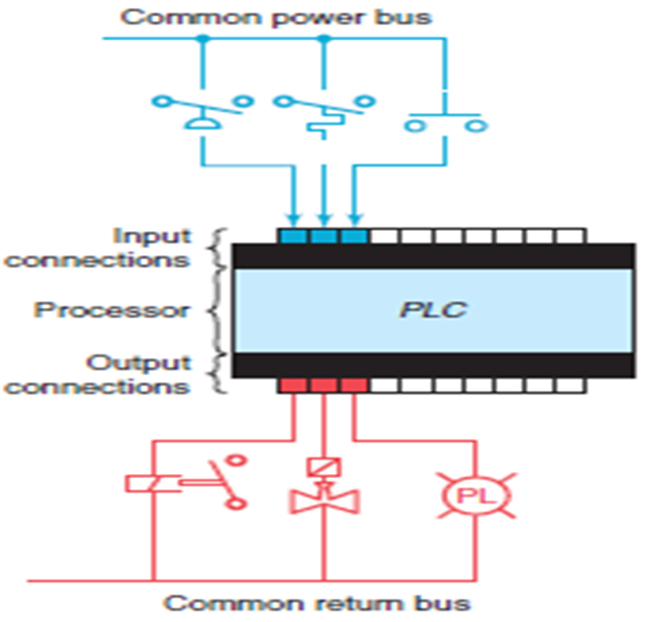
Programmable Logic Controller

Slide 4
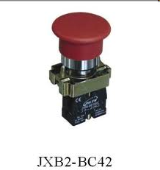
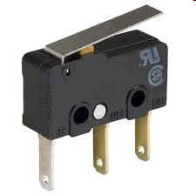
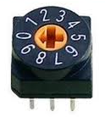
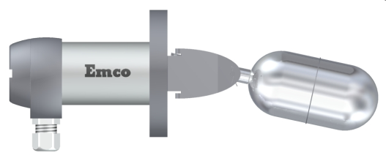
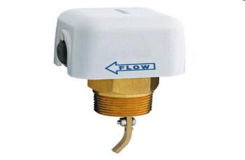
INPUT DEVICES:
Push Button
Limit Switch
Thumbwheel SW
Level SW
Flow SW

Slide 5
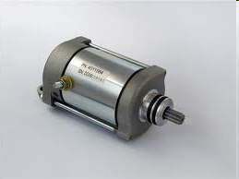
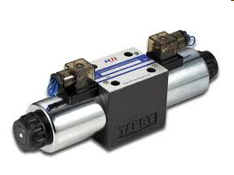
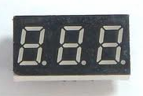
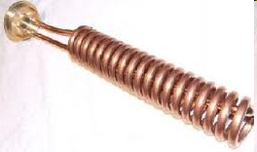

OUTPUT DEVICES:
Motor
Solenoid
LED Display
Heater Coil
Lamp

Slide 6
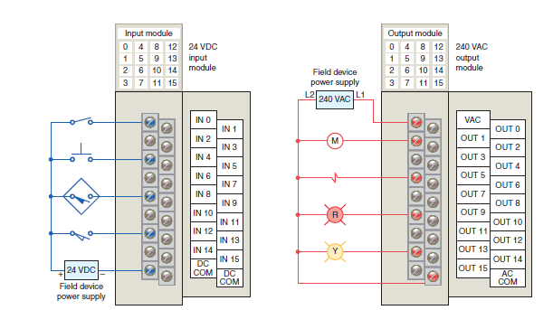
Typical PLC Input / Output (I/O) system connections

Slide 7
RELAYS..

Slide 8
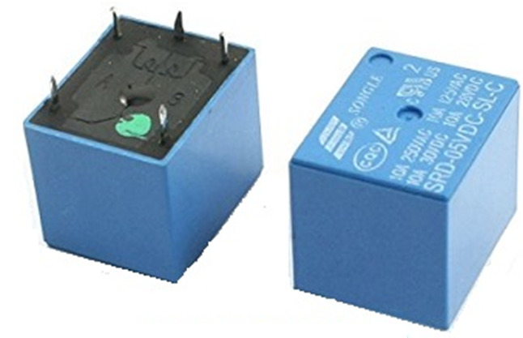

Relay …….
A relay is an electro-mechanical operator switch.
It is a hardware switching device to control the electrical circuit by using switching logic.

Slide 9
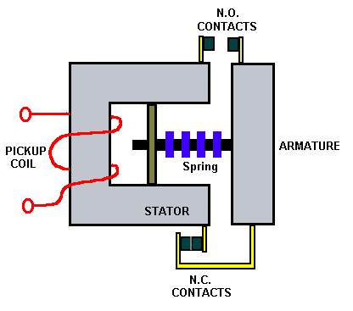
Relay
Simply: Relay has contacts and coil

Slide 10
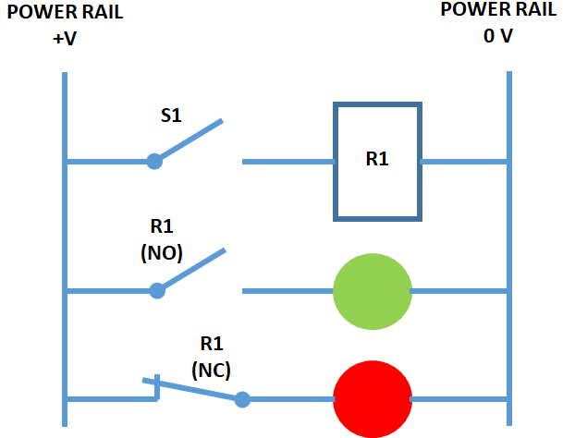
Two indicator lamps (RED and GREEN) are connected to a electromagnetic relay. A switch S1 is also connected to the coil terminal.
If S1 is closed GREEN bulb must glow, and when S1 is turned off RED bulb must glow. Develop relay logic diagram.

Slide 11

Seal-in contact (Relay logic diagram)
START STOP M
M

Slide 12
Programming languages
The IEC 61131-3 standard specifies five distinct forms of programming languages for industrial controllers:
Ladder Diagram (LD)
Structured Text (ST)
Instruction List (IL)
Function Block Diagram (FBD)
Sequential Function Chart (SFC)
Not all programmable logic controllers support all 5 language types, but nearly all of them support Ladder Diagram (LD), which will be our primary focus….

Slide 13
LADDER DIAGRAM
Programming languages for many industrial devices are limited by design.
One reason is simplicity: any programming language simple enough in structure for someone with no formal computer programming knowledge to understand is going to be limited in its capabilities.
Another reason for programming limitations is safety: the more flexible and unbounded a programming language is, the more potential there will be to unintentionally create complicated “run-time” errors when programming.

Slide 14
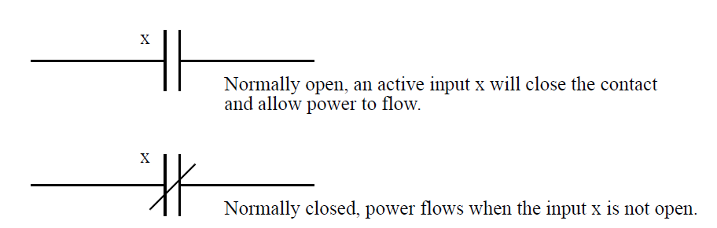
SYMBOLS USED:
INPUT SYMBOLS:

Slide 15
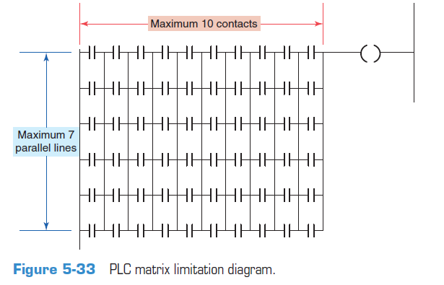
LADDER – related facts…

Slide 16
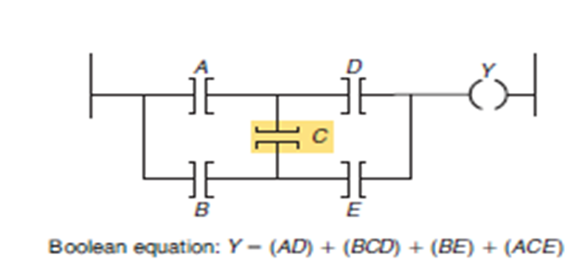
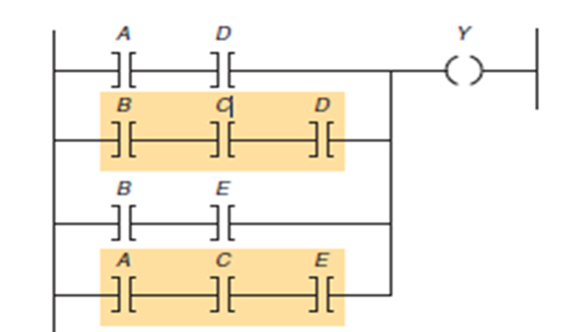
dos and don'ts

Slide 17
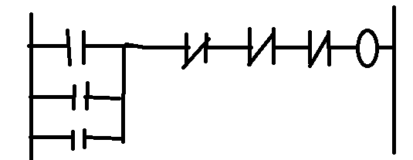
Example 1
A fan is to started and stopped from any one of the three locations.
Each location has a START & STOP button.
START (3) switches STOP (3) SWITCHES FAN
Soln:
The START switches as NO(NORMALLY OPEN) in parallel, &
The STOP switches as NC (NORMALLY CLOSED) in series….

Slide 18
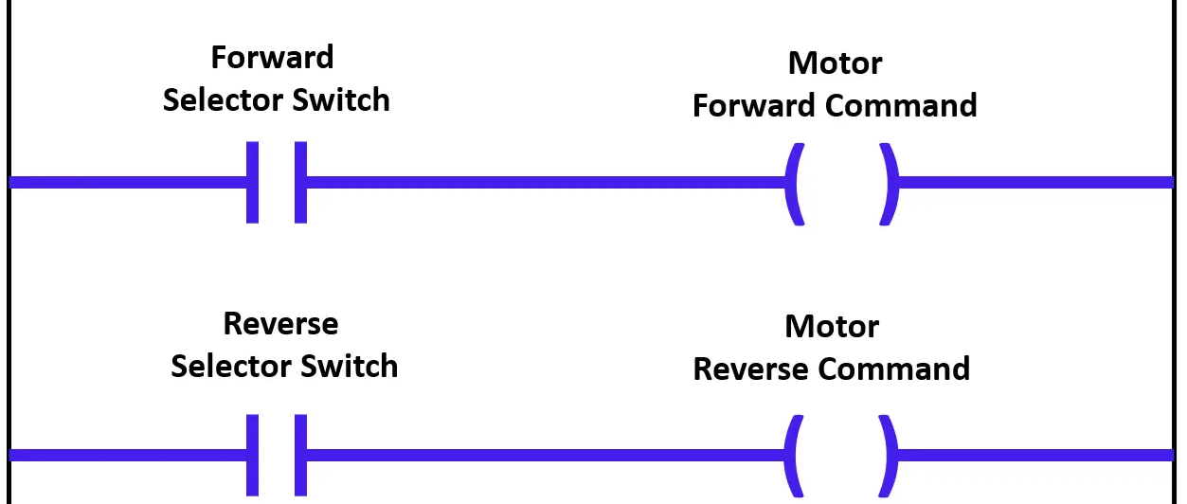
WITHOUT INTERLOCK
A motor can operate in two directions as per the operator selection.
The motor can rotate in the forward direction or in the reverse direction.
But the motor can rotate in only one direction at a time.
If we give both forward or reverse commands at the same time then the motor will be damaged.

Slide 19
Interlocking.. concept
In general, the motor logics are equipped with many safety functions and other motor-related pushbuttons like start, stop, and emergency stop.
we can avoid these problems with help of an interlock program. This program is called Interlock with the first input priority.
…………TO insert the NC status of motor output commands in the input side to implement this interlock logic.
Insert NC status of the reverse command with forward selector switch, ……..IIILY NC status of forward command with the motor reverse selection switch

Slide 20
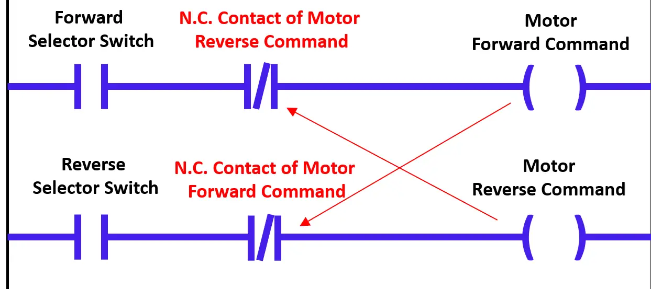
Forward- Reverse operation of motor with interlock
PLC Interlock Video Tutorial in Insrumentationtools.com

Slide 21
INTERLOCK further examples..
There are three machines, each with its own start-stop buttons. Only one may run at a time.
Construct a circuit with appropriate interlocking.

Slide 22
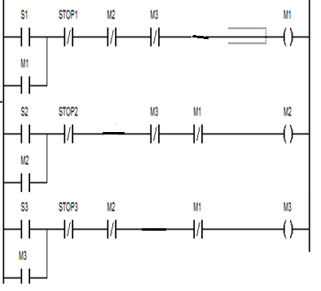

Slide 23
INTERLOCK example
There are three machines, each with its own start-stop buttons. Any two/one may run at a time.
Reconstruct circuit with appropriate interlocking.

Slide 24
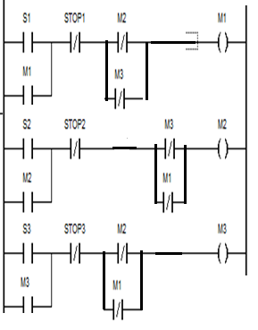

Slide 25
THANK YOU…

